Slide 1
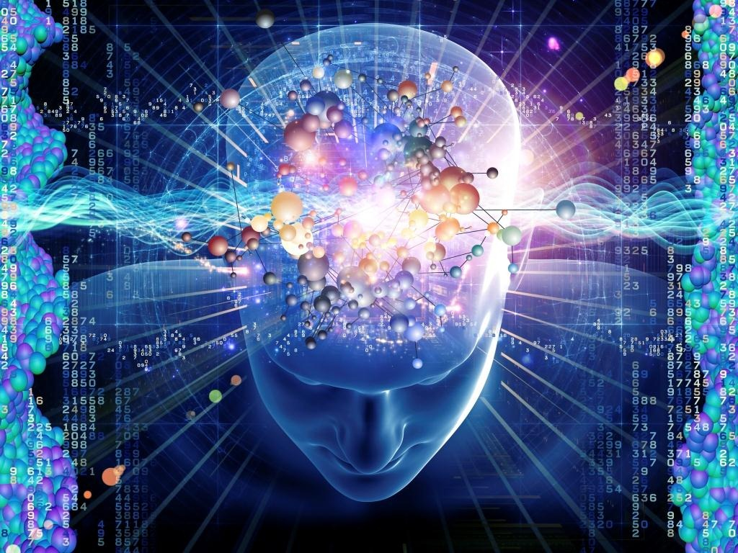

Emotional Intelligence

Slide 2


Slide 3
Emotional Intelligence (EI) Defined
Using this awareness to manage yourself and relationships with others
Ability to recognize and understand emotions

Slide 4

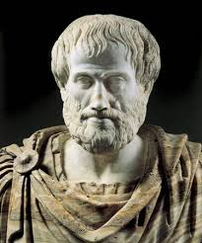
Aristotle says,
Anybody can become angry – that is easy, but to be angry with the right person and to the right degree and at the right time and for the right purpose, and in the right way – that is not within everybody’s power and is not easy.
Notes:
Introduction:
Impression management is a sociological and psychological concept that refers to the conscious or subconscious process by which individuals control or manipulate the information and impressions they convey to others. It involves shaping one's behavior, appearance, and communication in order to create a favorable image or perception in the eyes of others. Impression management plays a significant role in social interactions and can influence how people are perceived and treated by others.
Importance of First Impressions:
First impressions are crucial in various aspects of life, including personal relationships, professional settings, and social interactions. Here are some reasons highlighting the importance of first impressions:
Rapid Judgment: Humans are naturally inclined to make quick judgments about others based on their initial interactions. Research suggests that it takes only a fraction of a second for people to form a first impression.
Lasting Impact: First impressions tend to be persistent and can be challenging to change once established. People often use initial impressions as a reference point for future interactions.
Social and Professional Success: Whether in job interviews, business meetings, or dating scenarios, a positive first impression can open doors and create opportunities for success. Conversely, a negative first impression can hinder progress.
Trust and Likeability: Positive first impressions can foster trust, likability, and credibility, making it easier for individuals to build relationships and garner support from others.
Self-Esteem and Confidence: Creating a favorable first impression can boost an individual's self-esteem and confidence, leading to improved social and professional interactions.

Slide 5
4 Skills of Emotional Intelligence
WHAT I SEE
WHAT I DO
Emotional Intelligence
Self-Awareness
Self-Management
Social Awareness
Relationship Management
PERSONAL COMPETENCE
SOCIAL COMPETENCE
Notes:
Role of Grooming in Impression Management:
Grooming, which refers to the act of maintaining one's appearance and personal hygiene, plays a significant role in impression management. Here's how grooming contributes to shaping perceptions and impressions:
Appearance Matters: Physical appearance is one of the first things people notice when meeting someone for the first time. Proper grooming, including clean and well-maintained clothing, neat hair, and good personal hygiene, can convey professionalism, attention to detail, and self-respect.
Confidence Boost: Taking care of one's appearance can boost confidence and self-esteem. When individuals feel good about how they look, it often shows in their demeanor and interactions with others, making a positive impression.
Cultural and Contextual Considerations: Grooming standards can vary across different cultures and contexts. Understanding and adhering to the appropriate grooming norms for a specific situation can help individuals fit in and make a positive impression within that context.
Non-Verbal Communication: Grooming is a form of non-verbal communication that can convey respect for oneself and others. It can also signal professionalism, which is particularly important in business and career settings.
In conclusion, impression management is the process of controlling or influencing how others perceive us, and first impressions are of paramount importance in this regard. Grooming is an essential aspect of impression management as it can significantly impact how others perceive and judge us during initial interactions, ultimately shaping our personal and professional relationships.

Slide 6
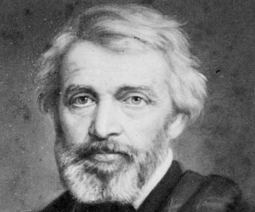
EI Starts with Self-Awareness
The greatest of faults is to be conscious of none
Self-Awareness
Ability to accurately perceive your own emotions
Stay aware of your emotions as they happen
Keep on top of how you tend to respond to specific situations and people
Thomas Carlyle
Notes:
Grooming, in the context of personal appearance, refers to the set of practices and activities individuals engage in to maintain and enhance their physical appearance and overall cleanliness. It encompasses various aspects such as clothing, hygiene, and the use of grooming products, all of which contribute to presenting a well-maintained and attractive appearance. Here's a breakdown of these key components:
Clothing: Grooming starts with the selection and maintenance of clothing. This includes choosing outfits that are appropriate for different occasions, ensuring they are clean, well-fitted, and in good condition. Dressing well can significantly impact how others perceive you and can boost your self-confidence.
Hygiene: Personal hygiene is a fundamental aspect of grooming. It involves practices such as regular bathing or showering, brushing teeth, maintaining clean and trimmed nails, and managing body odor. Proper hygiene not only promotes good health but also contributes to a pleasant and attractive appearance.
Grooming Products: Grooming products encompass a wide range of items used to enhance one's appearance. These may include skincare products like cleansers, moisturizers, and sunscreen to maintain healthy skin. Haircare products like shampoos, conditioners, and styling products help in managing hair appearance. Additionally, grooming products can also include cosmetics for those who choose to use makeup. Fragrances such as perfumes and colognes are also considered grooming products, as they can add a pleasant scent to one's overall appearance.
Effective grooming reflects a person's attention to detail, self-care, and respect for themselves and others. It not only contributes to a positive first impression but also boosts self-esteem and confidence, which can have a significant impact on personal and professional interactions. Ultimately, grooming plays a vital role in one's overall presentation and how they are perceived by others.

Slide 7
Improving Self-Awareness
Know Thyself
See yourself for who you are (what do you think and feel)
Watch your emotions like a hawk (even physiological signs)
Track & backtrack your emotions in a difficult conversation or meeting – learn your tendencies in emotionally arousing situations
Use paired sharing (peer or supervisor)
Own your actions – take full responsibility for what you say and do
Notes:
The Psychology of Impressions:
People are remarkably adept at forming quick impressions of others. This is often done through a process called thin-slicing, where individuals make rapid judgments about someone based on very limited information. Here are some key factors contributing to this ability:
First Impressions: First impressions are formed within milliseconds of meeting someone. These initial judgments can be influenced by a person's appearance, body language, and facial expressions.
Stereotypes: Stereotypes are mental shortcuts that help individuals categorize and make sense of the world. They can lead to quick impressions based on preconceived notions associated with certain characteristics, such as age, gender, race, and occupation.
Body Language: Non-verbal cues, such as posture, gestures, and eye contact, play a significant role in forming impressions. People often rely on these cues to assess a person's confidence, friendliness, and trustworthiness.
Context: The context in which you meet someone can shape your impression. For example, meeting someone at a job interview may lead to different impressions than meeting them at a social gathering.

Slide 8

Becoming Socially Aware
Social Awareness
Ability to accurately pick up on emotions in other people
Understand what is really going on
Understanding what other people are thinking and feeling even if you don’t feel the same way
Resolve to be tender with the young, compassionate with the aged, sympathetic with the striving and tolerant with the weak and wrong. Sometime in your life, you will have been all of these.
Gautama Buddha
Notes:
Impact of Non-Verbal Communication:
Non-verbal communication is a crucial element in impression formation. It encompasses a wide range of behaviors and cues that convey information without the use of words. Here's how non-verbal communication influences impressions:
Facial Expressions: Facial expressions convey emotions and can influence how others perceive you. A smile can make you appear friendly and approachable, while a frown may signal unhappiness or disapproval.
Body Language: Posture, gestures, and body movements can communicate confidence, openness, or insecurity. For example, standing up straight and maintaining eye contact can project self-assuredness.
Tone of Voice: The way you speak, including your tone, pitch, and speed, can convey a range of emotions and attitudes. A calm and pleasant tone can make you seem more likable and trustworthy.
Personal Space: Cultural norms dictate personal space boundaries, and respecting these norms is essential for positive impressions. Invading someone's personal space can lead to discomfort and a negative perception.

Slide 9
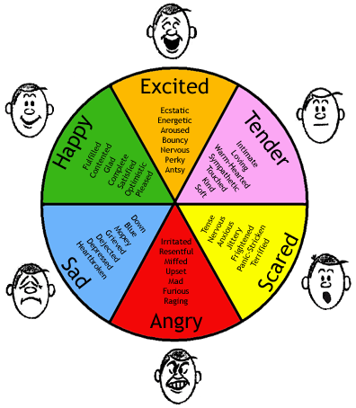
Improving Social Awareness
Spend extra time observing, asking & listening
Maintain eye contact
Give the speaker your full attention
Playback and summarize
Try on their shoes
Suspend your judgment
Read body language
Decipher emotions in speech tone
Notes:
Role of Grooming in Shaping Perceptions:
Grooming, which includes personal hygiene, clothing choices, and overall appearance, significantly impacts how others perceive you:
Cleanliness and Hygiene: Good personal hygiene is essential for making a positive impression. People tend to view those who are clean and well-groomed as responsible and respectful.
Clothing and Style: Clothing choices can convey a lot about a person's personality, profession, and social status. Dressing appropriately for a situation can enhance your credibility and attractiveness.
Attention to Detail: Paying attention to small details, such as neatly combed hair or well-maintained nails, can demonstrate your level of care and professionalism.
Cultural Sensitivity: In a diverse world, being aware of cultural norms and dressing appropriately for different contexts is crucial to avoid inadvertently offending or alienating others.
In conclusion, people form impressions quickly based on a combination of factors, including first impressions, stereotypes, body language, and non-verbal communication. Grooming and personal presentation also play a vital role in shaping these perceptions. Being mindful of how you present yourself and understanding the psychology behind impression formation can help you make positive impressions and build better relationships in various social and professional settings.

Slide 10

Use Awareness to Manage Relationships
Relationship Management
Ability to use awareness of your emotions and emotions of others to manage interactions successfully
Ensure clear communication and effective handling of conflict
People aren’t either wicked or noble. They’re like chef salads with good things and bad things chopped up and mixed together in a vinaigrette of confusion and conflict.
Lemony Snicket
Notes:
Grooming is a multifaceted concept that encompasses various components, each of which plays a significant role in personal presentation and impression management. Among these components, clothing, hygiene, hair and makeup, and accessories are key elements that individuals often use to convey their personal style, professionalism, and overall image. Let's delve into each of these components and explore their significance:
Clothing:
Significance: Clothing choices are a fundamental aspect of grooming, as they are one of the most visible elements of personal presentation. They serve as a means of self-expression and can convey information about a person's identity, style, and even their values or beliefs.
Professionalism: In professional settings, clothing plays a crucial role in making a positive impression. Dressing appropriately for the occasion or workplace can signify competence, attention to detail, and respect for established norms.
Self-Expression: Clothing choices allow individuals to express their personality and style. For example, someone who dresses conservatively may convey a different image than someone who embraces a more eclectic or casual style.
First Impressions: People often form initial judgments based on an individual's attire. Choosing clothing that aligns with the context and audience can help create a favorable first impression.
Hygiene:
Importance of Cleanliness: Personal hygiene is a cornerstone of grooming. It involves maintaining cleanliness in various aspects, including body, skin, nails, and oral hygiene. Proper hygiene not only promotes good health but also contributes to an overall well-groomed appearance.
Confidence and Comfort: Being clean and well-groomed can boost an individual's self-confidence and comfort in social and professional situations.
Perception of Professionalism: In professional settings, good hygiene is often associated with professionalism and attention to detail. It can enhance credibility and trustworthiness.
Hair and Makeup:
Hairstyles: Hair can significantly impact one's appearance. Different hairstyles can convey various messages, from professionalism and sophistication to creativity and individuality. Properly styled hair can complement an individual's overall look.
Makeup: Makeup is a tool that some individuals use to enhance their facial features or create a specific image. In professional settings, subtle and natural makeup is often preferred, while more elaborate makeup may be suitable for social or artistic contexts.
Impression Management: Hairstyles and makeup can influence how others perceive an individual. For instance, a neat and well-groomed hairstyle can project confidence and attention to detail, while excessive or unkempt styles may convey a lack of professionalism.
Accessories:
Role in Grooming: Accessories such as jewelry, belts, scarves, and watches play a complementary role in grooming. They can add a finishing touch to an outfit, showcasing attention to detail and style.
Expression and Individuality: Accessories allow individuals to express their personality and individuality. The choice of accessories can convey preferences, tastes, and even cultural or personal significance.
Contextual Consideration: The type and quantity of accessories should be considered in relation to the context. In formal settings, minimal and understated accessories may be preferred, while more casual or creative environments may encourage a broader range of choices.
In conclusion, grooming involves careful consideration of clothing, hygiene, hair and makeup, and accessories to present oneself effectively in various personal, social, and professional contexts. Each of these components plays a crucial role in shaping first impressions, conveying personal identity, and influencing how others perceive and interact with an individual. Ultimately, grooming is a tool for self-expression and impression management that can have a significant impact on personal and professional success.

Slide 11
Improving Relationship Management
Seek to build high quality, high trust relationships
Try to discover what role emotions are playing in your interactions with others
If you sense tension or other emotional reactions in a person’s body language or speech, ask questions to seek to understand
Be quick to settle disputes, differences of opinion and misunderstandings

Slide 12
What does EI have to do with ECP?
WHAT I SEE
WHAT I DO
Self-Awareness
Ability to accurately perceive your own emotions
Stay aware of your emotions as they happen
Keep on top of how you tend to respond to specific situations and people
Self-Management
Ability to use awareness of your emotions to stay flexible and positively direct your behavior
Managing your emotional reactions to all situations and people
PERSONAL COMPETENCE
Social Awareness
Ability to accurately pick up on emotions in other people
Understand what is really going on
Understanding what other people are thinking and feeling even if you don’t feel the same way
Relationship Management
Ability to use awareness of your emotions and emotions of others to manage interactions successfully
Ensure clear communication and effective handling of conflict
SOCIAL COMPETENCE
Notes:
Essential grooming products can help you look and feel your best. Here's a list of key grooming categories and recommendations for selecting the right products:
1. Skincare:
Cleanser: Choose a gentle cleanser suitable for your skin type (normal, oily, dry, or sensitive). Look for ingredients like salicylic acid or glycolic acid for exfoliating cleansers.
Moisturizer: Find a moisturizer with SPF for daytime use and a hydrating, non-comedogenic formula for nighttime.
Sunscreen: Protect your skin from UV damage by using a broad-spectrum sunscreen with at least SPF 30.
Serum: Consider adding a serum with active ingredients like hyaluronic acid, vitamin C, or retinol to address specific skincare concerns.
Eye Cream: An eye cream can help reduce puffiness and dark circles. Look for one with ingredients like peptides or caffeine.
2. Haircare:
Shampoo and Conditioner: Choose a shampoo and conditioner that match your hair type (e.g., dry, oily, curly, straight) and address specific concerns (e.g., dandruff, color protection).
Styling Products: Use products like hair gel, pomade, or mousse for styling. Select products based on your desired hairstyle and hair type.
Hairbrush/Comb: Invest in a high-quality brush or comb that suits your hair texture to prevent damage and promote healthy hair.
3. Fragrance:
Cologne/Perfume: Find a scent that matches your personality and occasions. Consider the concentration (eau de toilette, eau de parfum) for the desired longevity.
Aftershave: If you use it, select an aftershave that soothes and hydrates your skin while providing a pleasant scent.
4. Shaving:
Razor: Choose between safety razors, disposable razors, or electric razors, depending on your preference.
Shaving Cream/Gel: Pick a shaving cream or gel that lubricates the skin to prevent irritation and razor burns.
Aftershave Balm: Apply a soothing aftershave balm to hydrate and calm the skin after shaving.
5. Oral Care:
Toothbrush: Opt for a soft-bristle toothbrush with good ergonomics for effective cleaning.
Toothpaste: Select a fluoride toothpaste that meets your dental needs, such as whitening, sensitivity, or gum health.
Mouthwash: Use a mouthwash to freshen breath and kill bacteria. Look for alcohol-free options if you have sensitive gums.
6. Grooming Tools:
Nail Clippers: Invest in quality nail clippers to maintain well-groomed nails.
Tweezers: High-quality tweezers are essential for plucking unwanted hairs.
Grooming Kit: Consider a comprehensive grooming kit that includes scissors, a comb, and other essential tools for maintaining your appearance.
Tips for Choosing Grooming Products:
Know Your Skin and Hair Type: Understanding your skin and hair type is crucial for selecting the right products that cater to your specific needs.
Read Labels: Pay attention to ingredient lists, especially for skincare products, to avoid potential allergens or irritants.
Patch Test: When trying new skincare or grooming products, conduct a patch test to ensure you don't have adverse reactions.
Consider Your Goals: Identify your grooming goals, whether it's clear skin, a specific hairstyle, or a signature scent, and choose products accordingly.
Invest Wisely: High-quality grooming products may cost more upfront, but they often yield better results and last longer.
Stay Consistent: Establish a daily grooming routine and stick with it to see the best results from your products.
Remember that grooming products are not one-size-fits-all, so it's important to tailor your choices to your unique needs and preferences for the best results.

Slide 13
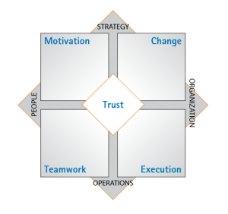
What does EI have to do with ECP? Organizational Engagement – Vital Signs
Trust: People have a sense of safety & assurance to share and go beyond their comfort zones
Motivation: People feel energized and committed to doing more than the minimum
Change: Employees and institutions are adaptable and innovative
Teamwork: People collaborate and communicate to take on challenges
Execution: Individuals are both focused and accountable
Notes:
In conclusion, the presentation highlighted several key points regarding the importance of impression management through grooming.
First impressions matter: Research consistently shows that people form lasting impressions within seconds of meeting someone. Grooming plays a pivotal role in shaping these initial perceptions.
Personal branding: Grooming is an integral part of personal branding. It communicates a message about your professionalism, attention to detail, and self-respect.
Confidence boost: Taking care of your appearance can boost your self-confidence and self-esteem, leading to improved interactions and opportunities.
Professional success: In many professional settings, grooming standards are essential. A well-groomed appearance can enhance career prospects and foster a positive workplace image.
Cultural and situational awareness: Understanding the appropriate grooming standards for different cultures and situations is crucial for effective impression management.
Long-lasting impact: Grooming isn't just about the initial impression; it can have a long-lasting impact on how others perceive and remember you.
In conclusion, impression management through grooming is a vital aspect of personal and professional success. It goes beyond vanity and aesthetics, influencing how we are perceived, the opportunities we receive, and our overall self-confidence. Investing time and effort in grooming is an investment in our social and career advancement.

Slide 14
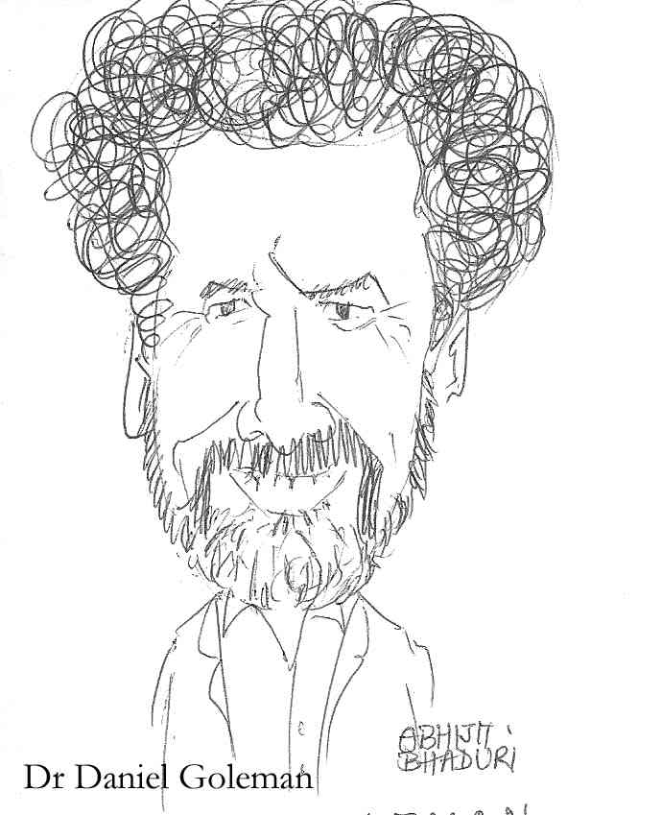
Final Thoughts
If your emotional abilities aren’t in hand, if you don’t have self-awareness, if you are not able to manage your distressing emotions, if you can’t have empathy and have effective relationships, than no matter how smart you are, you are not going to get very far.

Slide 15
THANK YOU

